Slide 1
INSTITUTE NAME : BANNARI AMMAN INSTITUTE OF TECHNOLOGY
PROJECT TITLE : SMART SECURITY SURVEILLANCE USING IOT
PRESENTED BY : VIGNESH.J
JASON.J
BHAVAGURUBURAN.A

Slide 2
PROBLEM STATEMENT
Now a days the technology has been improved a lot in all the fields but when it comes to home security there is no drastic change in it for this we have developed a well improved home surveillance system using IOT.
SOLUTION
In this work we proposed a technique to smart security surveillance using Raspberry Pi, PIR sensor and camera module. Smart security surveillance using IoT with PIR sensor and camera module is an interesting idea to involve detection of sensing of the moving object and generate responses for better security.
DESCRIPTION OF IDEA
The proposed system is based on PIR sensor and camera module connected to Raspberry Pi along with other system peripherals.There are two actors in the proposed system of IoT doorbell. One is the guest and another one is the admin or the user. Admin will be able to login and see what is happening in front of the doorbell in real time. The visitors can press the push button and the notification will be sent to the admin along with his or her photo. But if the visitor wouldn’t press the button it will simply send the notification along with the photo directly to the user.

Slide 3
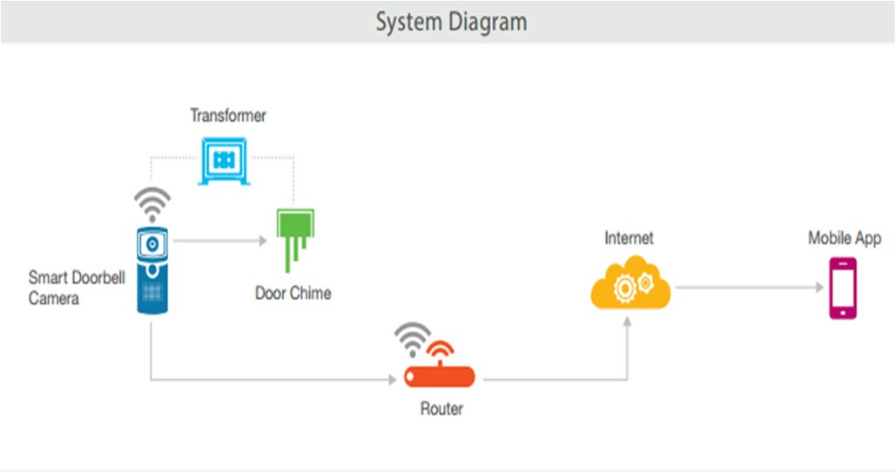
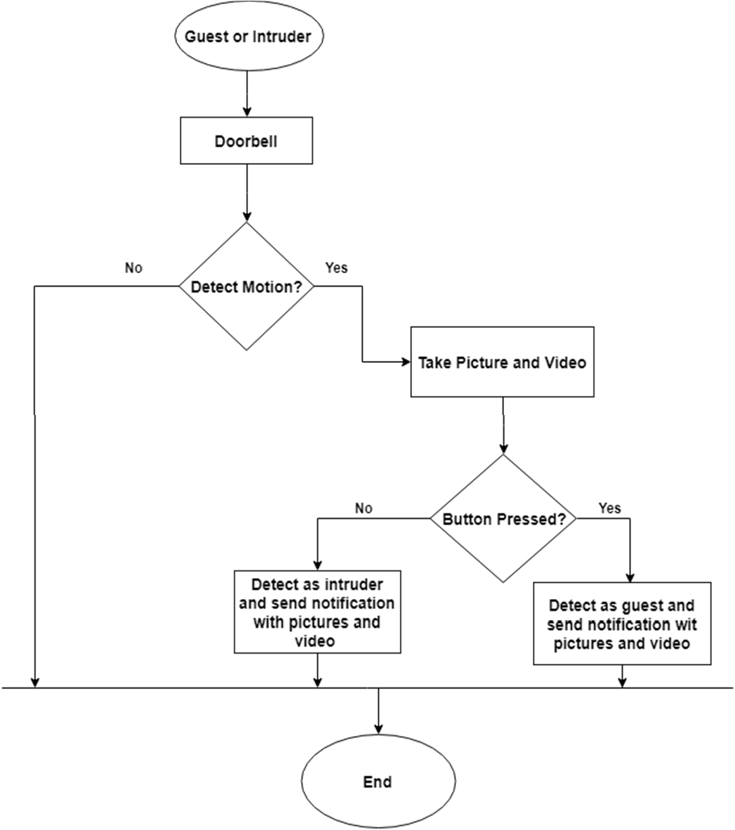
PROTOTYPE
DETAILED IDEA OF THE PROJECT

Slide 4
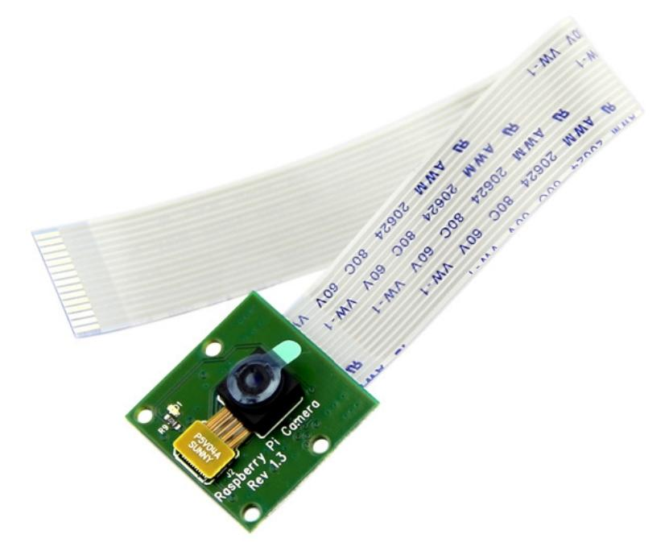
DESCRIPTION OF USE CASES
In this research work, we developed security surveillance system using Raspberry Pi along with PIR motion sensor and camera module. We experimented with PIR sensor in association with camera module for detail understanding of the motion sensing and thereafter triggering of the camera module and detection of intruders on real-time basis. The surveillance system is tested for intruder detection. The proposed system using PIR sensor and camera module can be further enhanced for face detection and recognition based on threshold of changes and using CV.

Slide 5
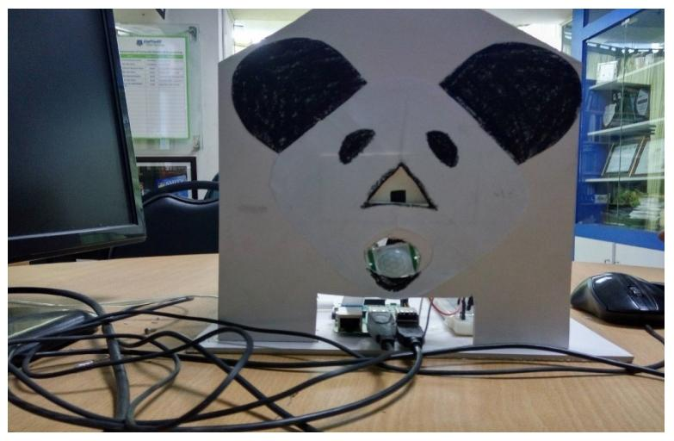
RESULT
The experimental setup is configured using Raspberry Pi with all necessary library modules for GPIO connectivity and PIR sensor along with the camera module programming using Python language.We developed the program modules for interactions with PIR sensors and GPIO to trigger PIR sensor and camera module and read data from the GPIO for necessary speed calculation.

Slide 6


